Slide 1
Active Lowpass Filter
Skill demo 2

Slide 2
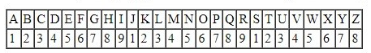

Calculation
$$α1=Y=7$$
$$β1=M=4$$
Gain = 2+7=9 V/V
Cutoff = 10+(5*4) = 30 Hz

Slide 3

Data:
$$f=30Hz$$
$$C=470nF$$
Lowpass Filter Formula: $$f=\frac{1}{2∗π∗R∗C}$$
$$R=\frac{1}{2∗π∗C∗f}$$
$$R=\frac{1}{2∗π∗\left(470n\right)∗\left(30\right)}$$
$$R=11287.58Ω≈11kΩ$$
We are using the inverting amplifier
$$Gain=A=9$$
$$A=\frac{R_{f}}{R_{in}}$$
$$R_{f}=11kΩ$$
$$R_{in}=\frac{11k}{9}$$
$$R_{in}=1222≈1200Ω$$

Slide 4
Simulation
We have used the NI Multisim for the simulation of the circuit.
Our filter consist of 741 op-amp in the inverting amplifier configuration.

Slide 5
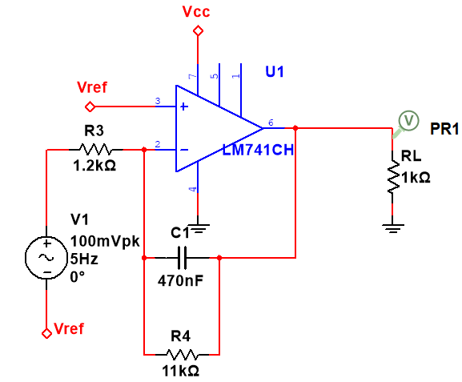
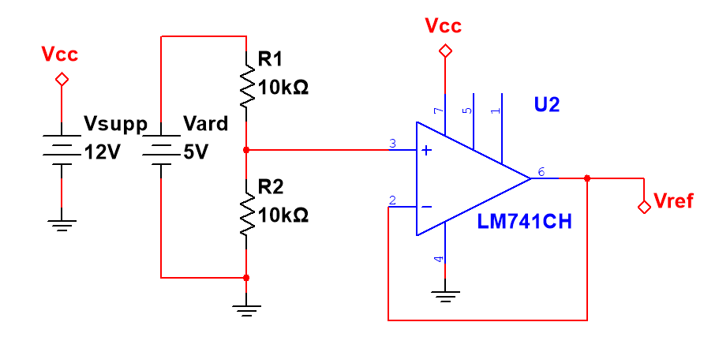
Virtual Ground Circuit
Active Lowpass Filter

Slide 6
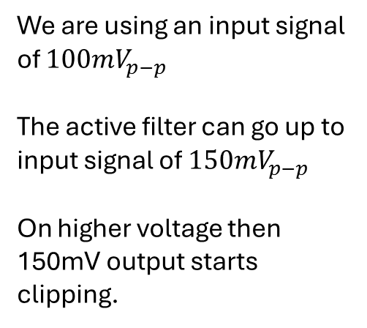
Vref is the reference voltage from the virtual ground circuit which is 2.5V
We are using an input signal of $100mV_{p−p}$
The active filter can go up to input signal of $150mV_{p−p}$
On higher voltage then 150mV output starts clipping.
Lowpass Filter

Slide 7
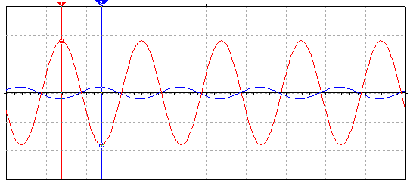

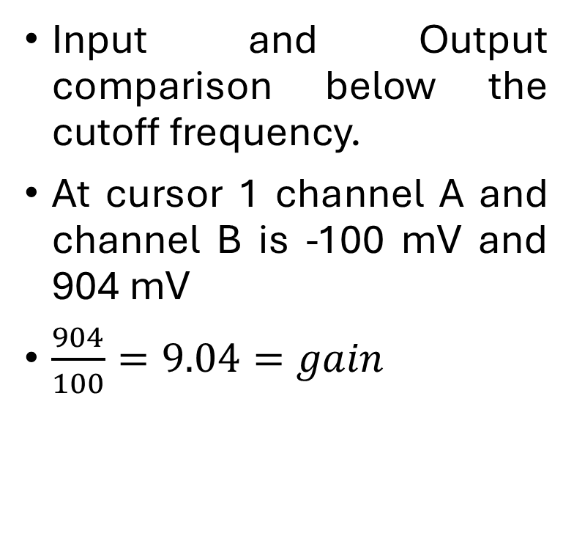
Simulation
Input and Output comparison below the cutoff frequency.
At cursor 1 channel A and channel B is -100 mV and 904 mV
$\frac{904}{100}=9.04=gain$
Channel A(INPUT)
Channel B(OUTPUT)

Slide 8
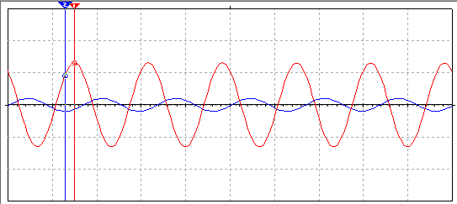

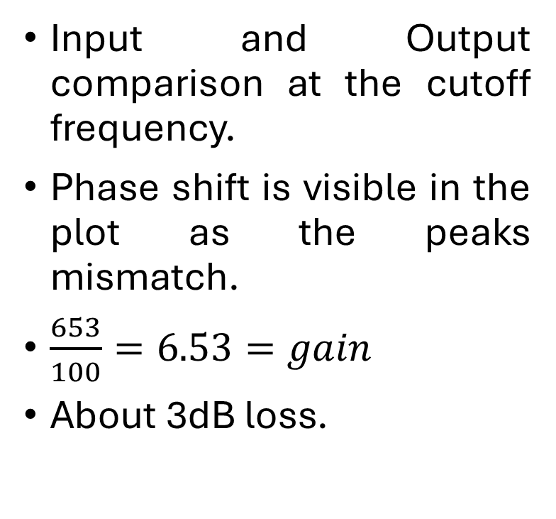
Simulation
Input and Output comparison at the cutoff frequency.
Phase shift is visible in the plot as the peaks mismatch.
$\frac{653}{100}=6.53=gain$
About 3dB loss.
Channel A(INPUT)
Channel B(OUTPUT)

Slide 9
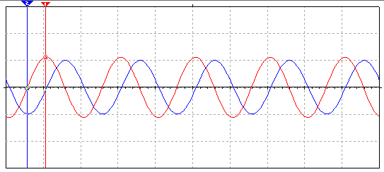


Simulation
Input and Output comparison above the cutoff frequency.
$\frac{56}{100}=0.56=gain$
Channel A(INPUT)
Channel B(OUTPUT)

Slide 10
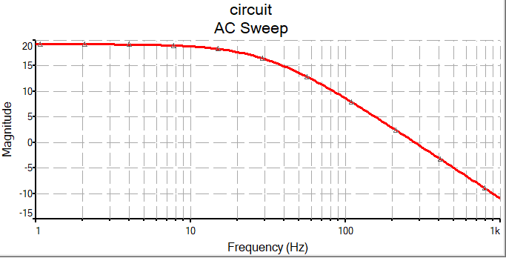
Frequency Analysis

Slide 11
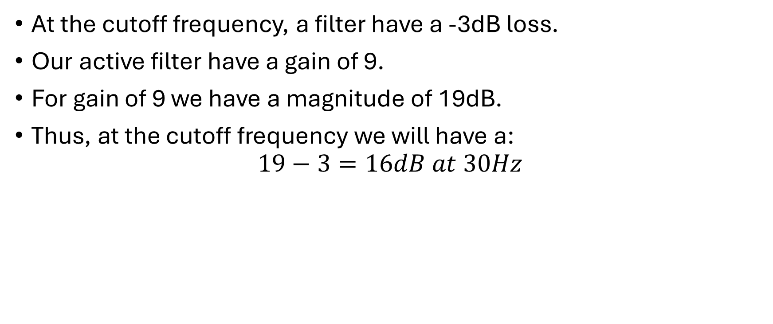
At the cutoff frequency, a filter have a -3dB loss.
Our active filter have a gain of 9.
For gain of 9 we have a magnitude of 19dB.
Thus, at the cutoff frequency we will have a:
$$19−3=16dB at 30Hz$$

Slide 12
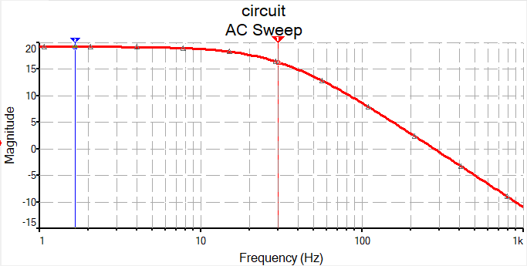
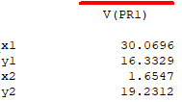

Slide 13
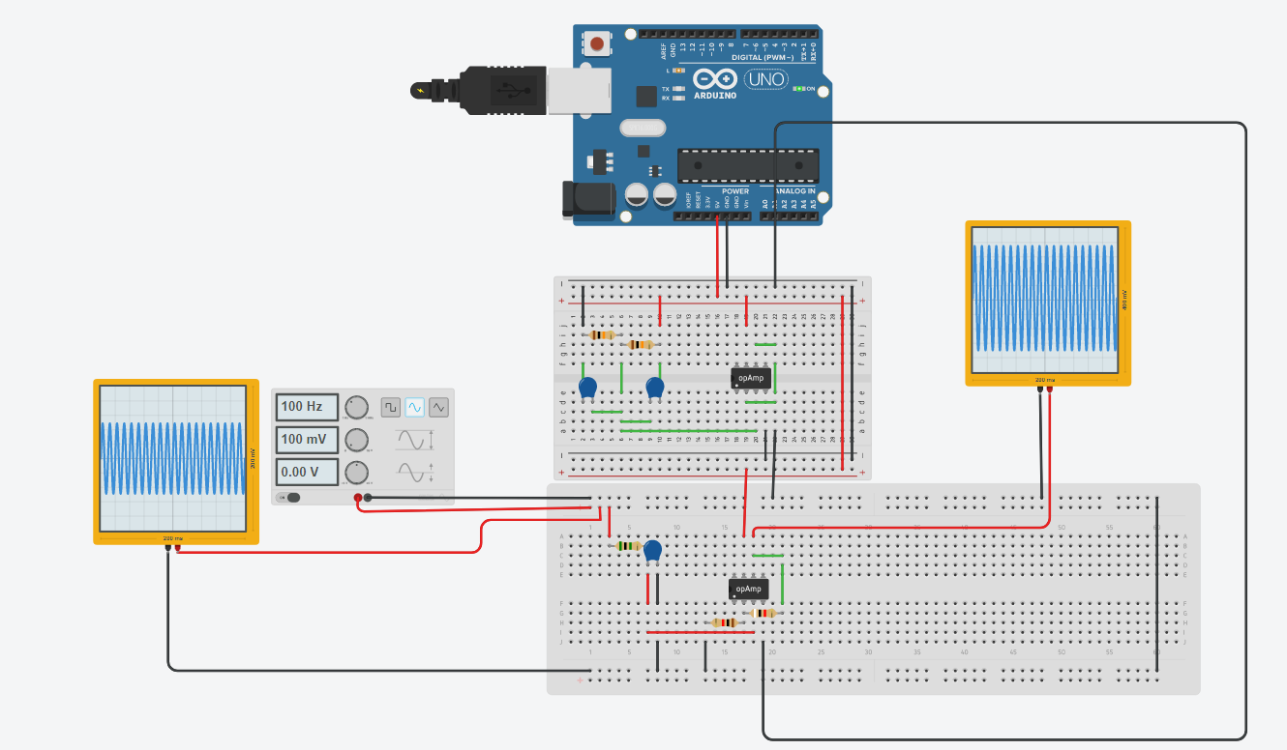

Slide 14
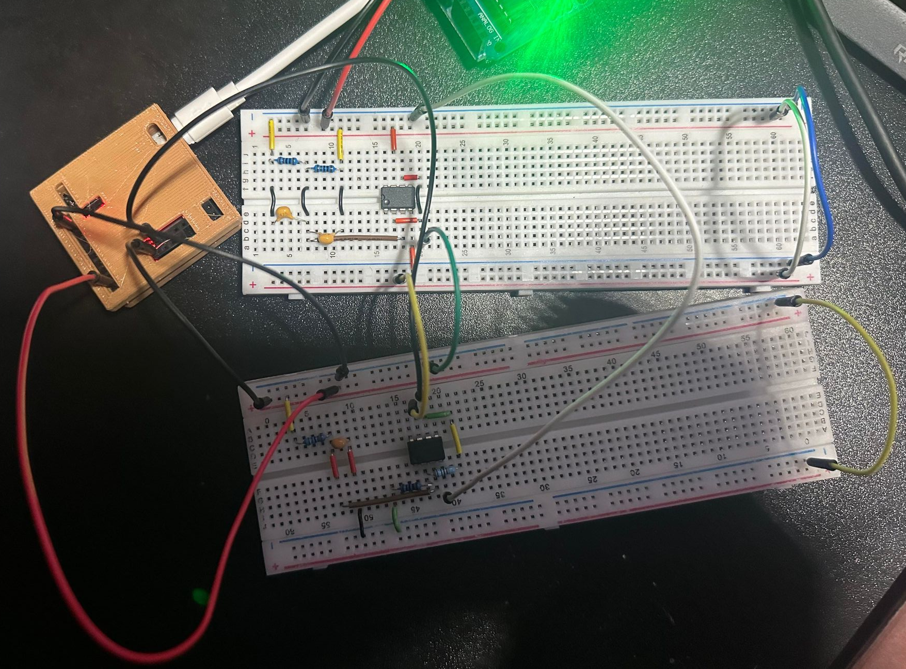

Slide 15
Labrador board
Arduino
Virtual Ground
Active Low pass filter

Slide 16
